Slide 1
DEFCON 33
"Shaping the Future of Money…
with AI, Crypto and Gold"
A Disruptive Venture

Slide 2
Presentation Overview
Introduction
History
Gold Token White Paper
Token Platform (SDT)
Results
Certain Things Are Likely
Notes:
ChatGPT uses will be spread out in the presentation

Slide 3
Why Listen To Me?
Synopsis: A stablecoin proposal for State governments, including some history, economics, gold depositories, Bitcoin reserves, pending legislation, impact of “vibe coding” and BRICS.
35 Years Of Software Development
7 Tech Startups
Digital Money Trust (Grabbe) in 1994
3 DEFCON Presentations On Predictive Analytics, 2005-2007
Sila Money Stablecoin, 2018

Slide 4
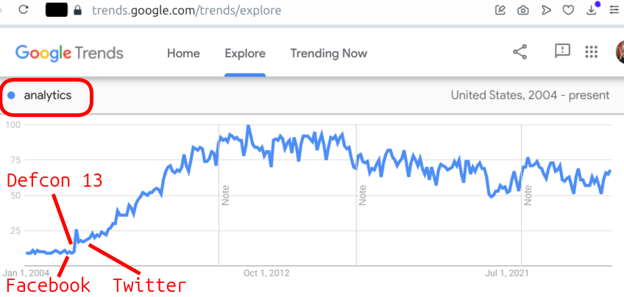
Followup To My Defcon 13 Presentation (2005)

Slide 5
History

Slide 6
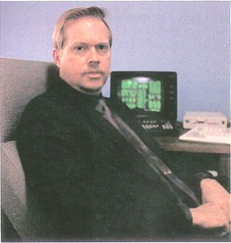
J. Orlin Grabbe
Financial Trading
Conspiracy Theorist
The End Of Ordinary Money (1995)
Digital Money Trust (1999-2004)

Slide 7
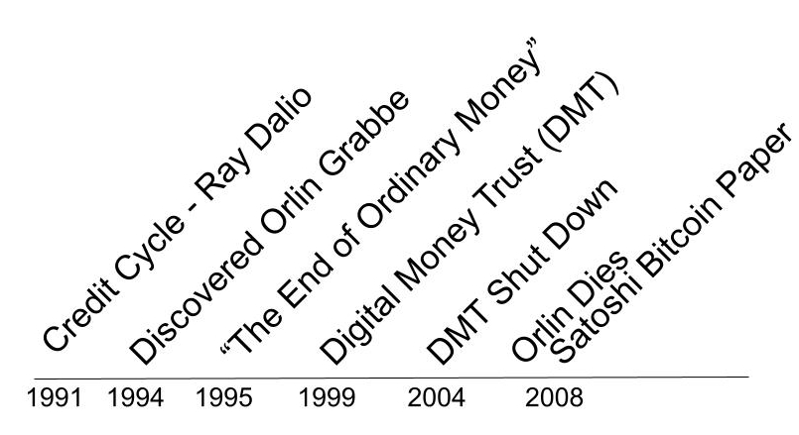
Narrative Arc
Notes:
2014 - ShazzleMail project, email and Russia programmers
2018 - Sila Money

Slide 8
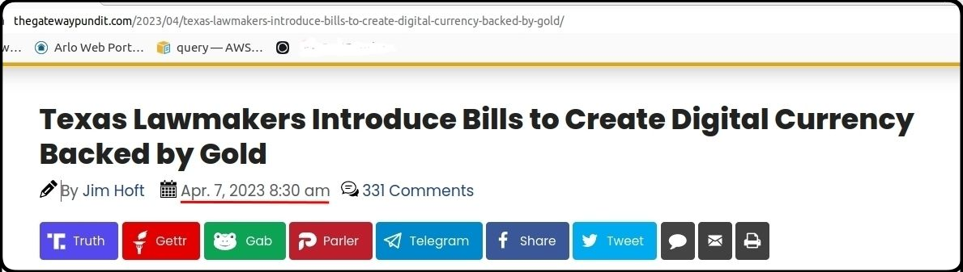
Texas Gold Bullion Depository
Most folks won’t recognize what the Texas Gold Bullion Repository is but I did, thanks to Orlin Grabbe.
So I’ve expected this since 2018…

Slide 9
Gold Token White Paper
First mailing in April 2023
Notes:
Excerpts from Gold Token White Paper

Slide 10
White Paper Overview
Original paper created with ChatGPT
A comprehensive (I hope) national strategy
Mostly about WHY a State platform, not HOW
This presentation includes more about HOW

Slide 11
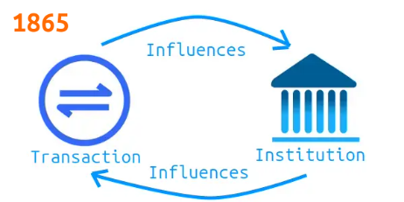
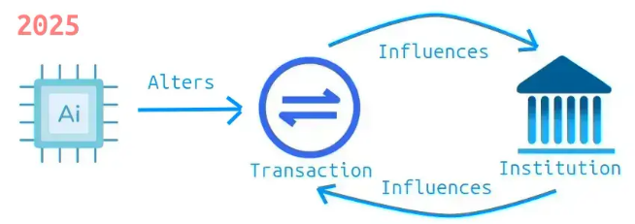
Transaction Theory
Notes:
Coase transaction theory of Reflexive relationships.
What was problematic in 1865 is an opportunity in 2025

Slide 12
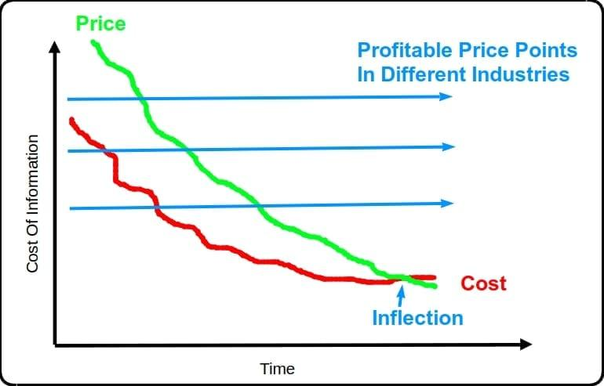
Falling Transaction Costs Create Opportunity

Slide 13
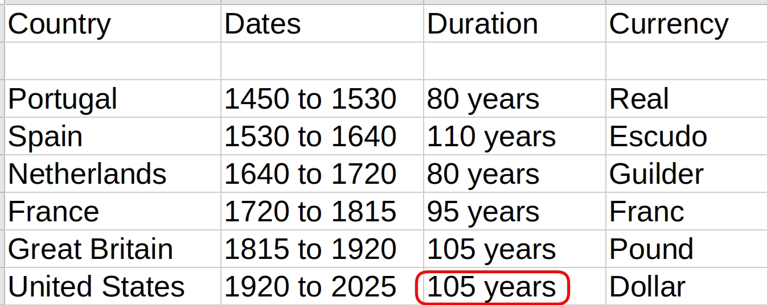
Hegemonic Empires Last 95 Years
United States is past the average expiration date
Notes:
The “Three Generation” problem - Creators, Caretakers, Freeloaders

Slide 14
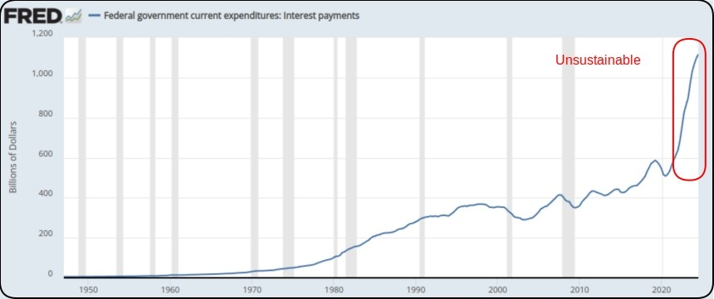
Unsustainable Federal Interest Payments

Slide 15
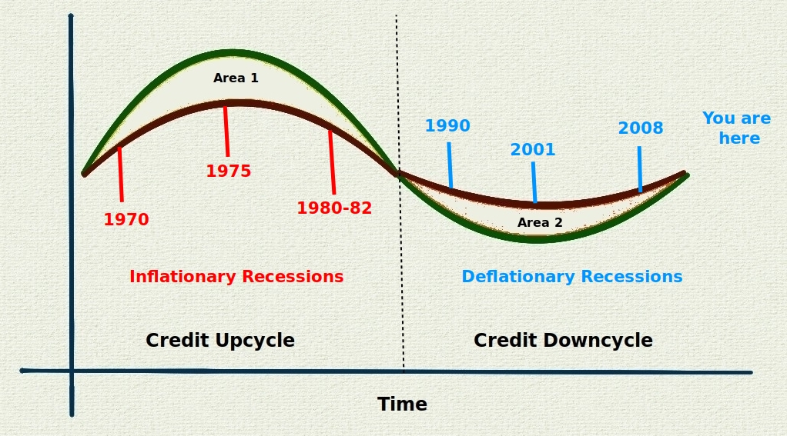
Full Credit Cycle (60 Years)
Notes:
Based on “Depression, Not Recession” by Ray Dalio in 1991, Barron’s

Slide 16
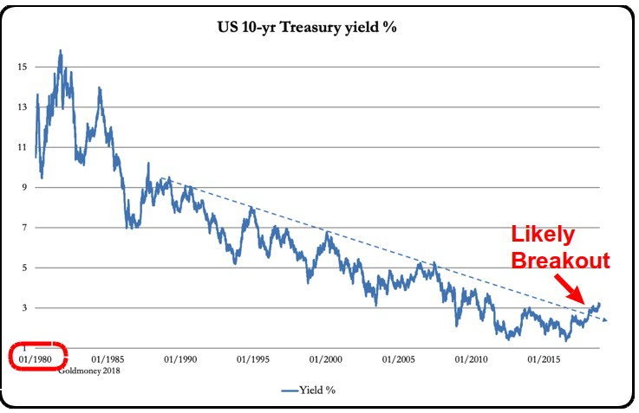
Half Credit Cycle, Interest Rates May Rise

Slide 17
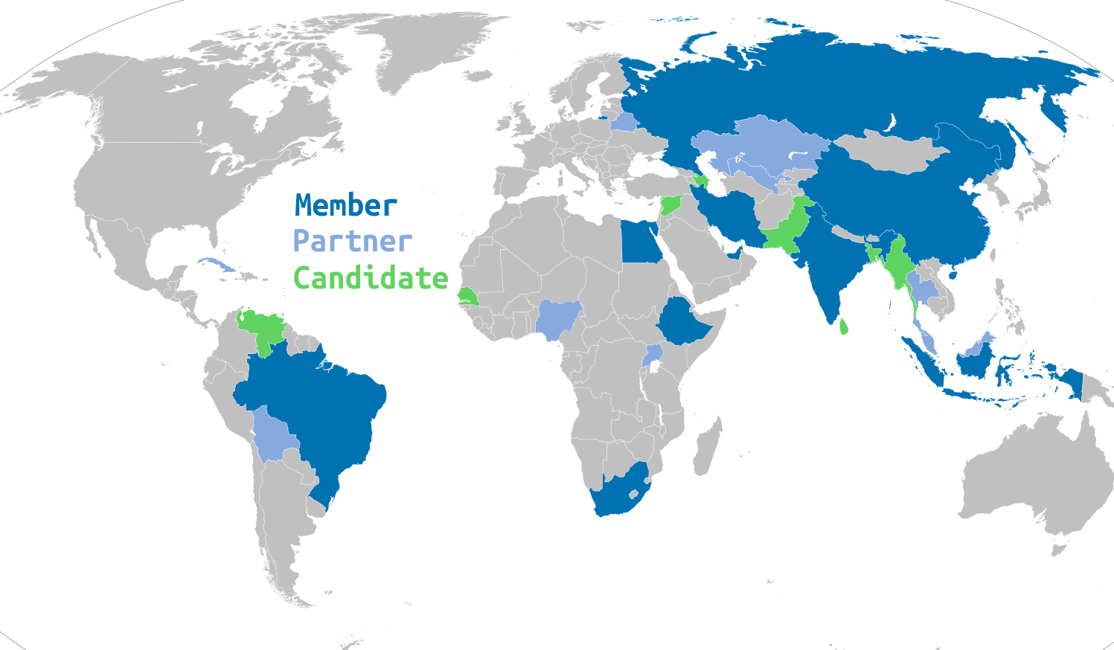
BRICS De-Dollarization Risk
Notes:
The sum of these trends is that we need a pro-active solution to a future dollar crisis

Slide 18
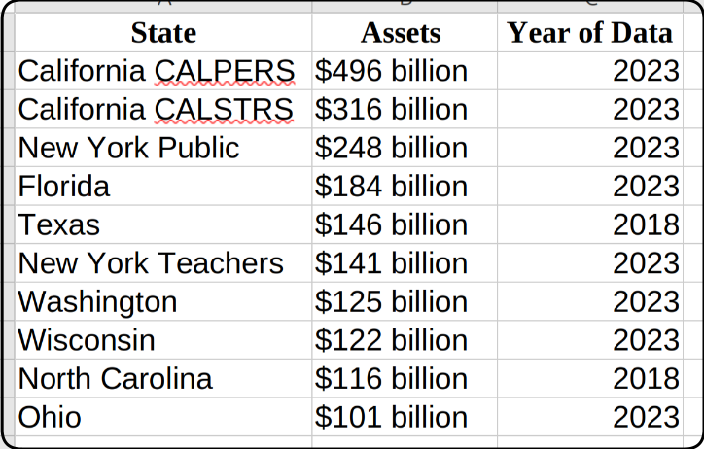
Top Ten State Pension Funds At Risk

Slide 19
Token Platform
(SDT)

Slide 20
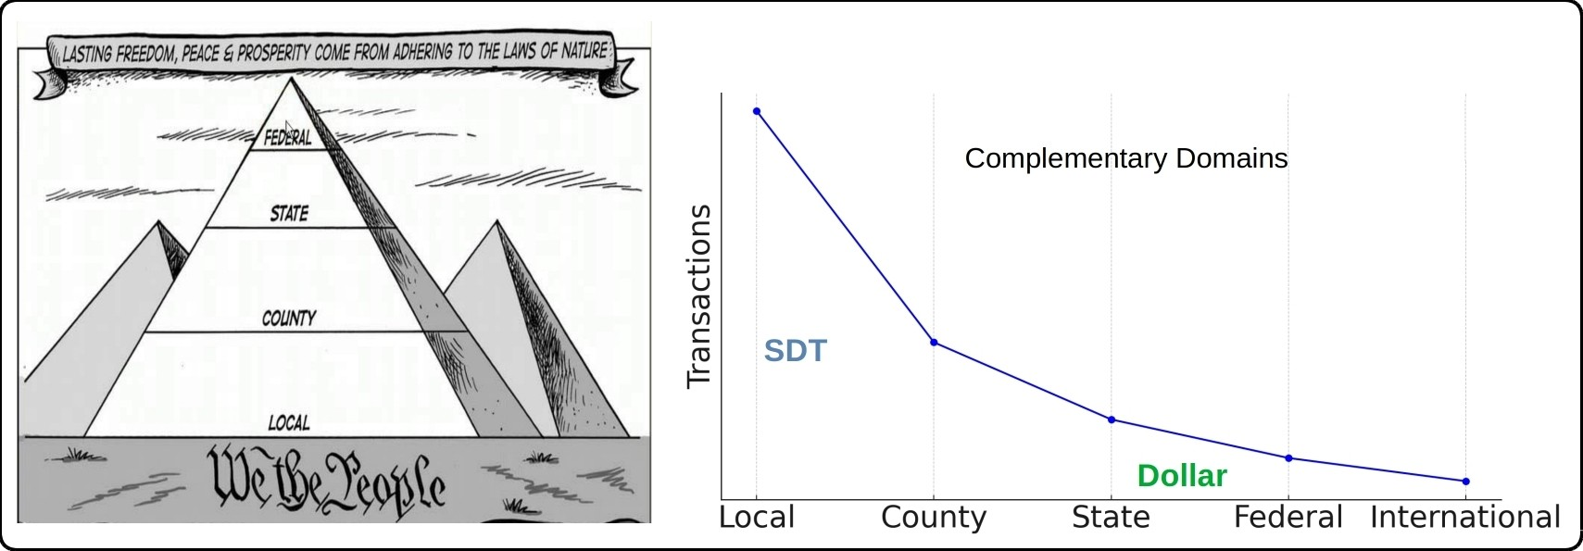
Parasocial Money
Parasocial relationships are one-sided, where one party expends effort on an oblivious recipient, like a celebrity and their fans.
Or today’s dollar and American taxpayers.
Notes:
Most economic transactions are local, so a regional currency will be more responsive to local conditions.

Slide 21
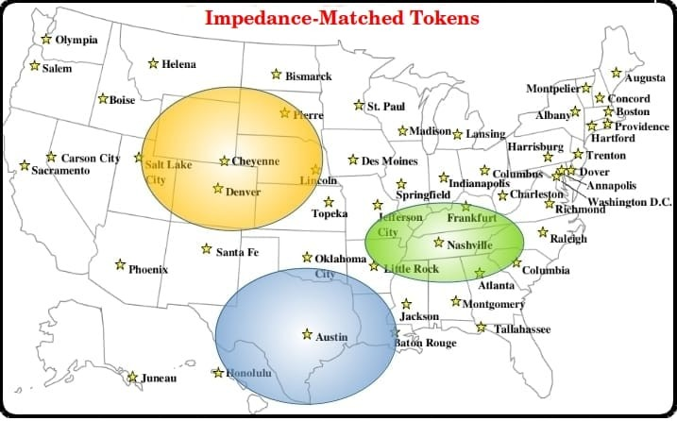
Impedance-matched Tokens
Notes:
Token platforms operate at a regional level like the original Federal Reserve banks

Slide 22
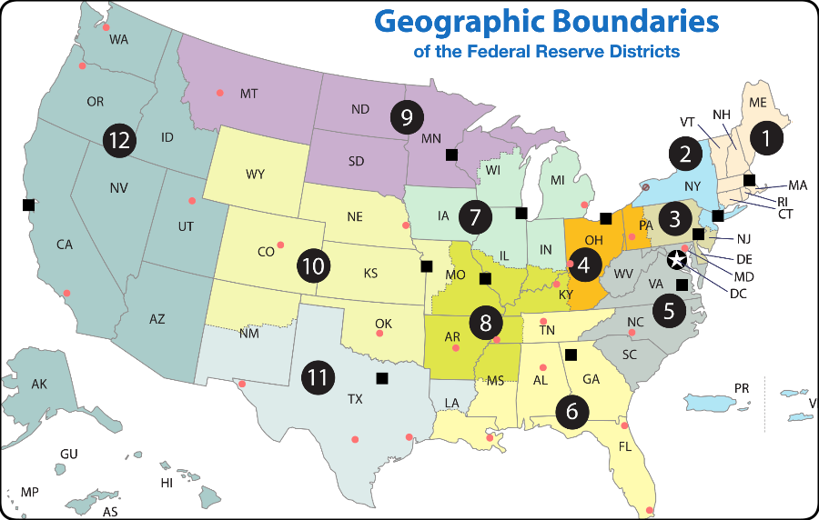
Federal Reserve Banks

Slide 23
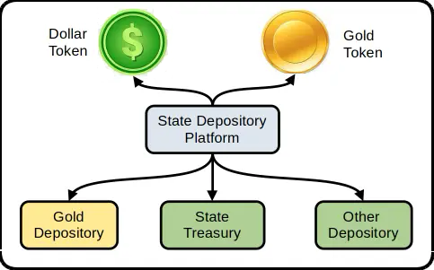
SDT Platform
An impedance-matched SDT platform adapts to regional conditions and provides multiple token types: dollar, gold or bitcoin.
Notes:
Dollar and Gold: complex objects are resolved into a single dimension (Price).
Crypto Platform can model with more dimensions - different backing, asymmetrical exchange rates, etc

Slide 24
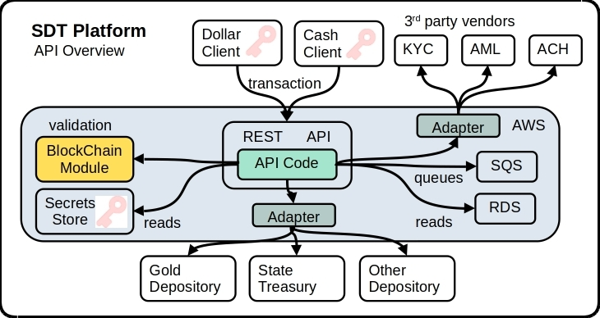
Component Overview

Slide 25
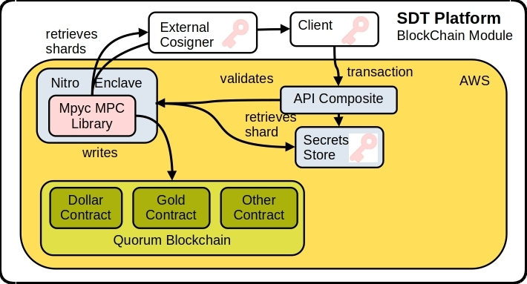
Blockchain Module

Slide 26
ChatGPT Research
15 Components glued together by AI code.
ACH, KYC & AML: 3rd-party API Language: Python ver 3.9
Blockchain: Quorum
Database: AWS RDS
ORM: Django
Transport: AWS Lambda
Security: MPC Library mpyc
Queue: AWS SQS
Vault: AWS Nitro Enclave
Schema: OpenAPI - Editor
Stablecoin: Quorum Custom
Depositories: Proprietary API
Config Mgmt: SimpleJson
Integration Test: Localsource

Slide 27
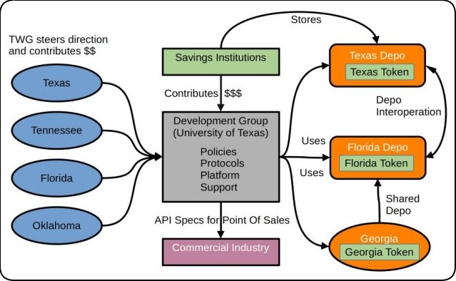
Technical Working Group (TWG)

Slide 28
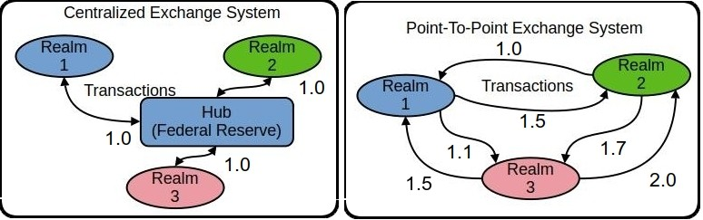
State Exchange Systems (SXS)
Hub and Spoke: centralized, scalable, simple but rigid
Point-to-Point: flexible but complex and limited scale
Point-to-point allows multiple, asymmetrical exchange rates
and probably the how the new BRICS currency system works
Notes:
Steak, Chicken and Fish model to demonstrate monetary rigidity

Slide 29
RESULTS
Mailed 600 copies to 8% of all legislators (7,386)

Slide 30
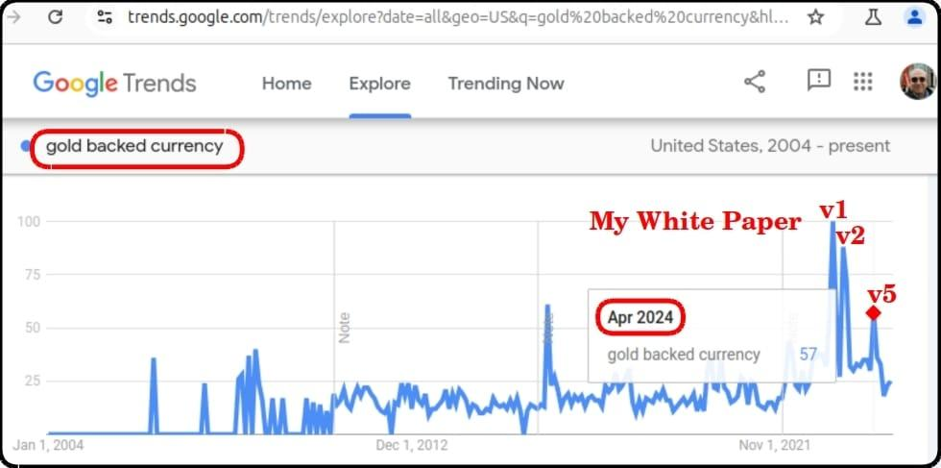
Google Trends Feedback
Notes:
I sent out five versions to five different audiences in 2023. You can see the reaction of the #1, #2 and #5 audiences.

Slide 31
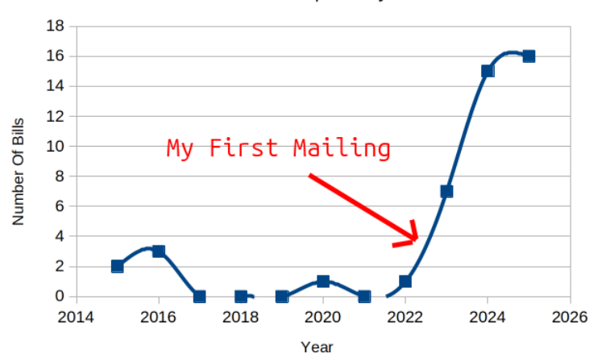
Gold Depository Bills Submitted

Slide 32
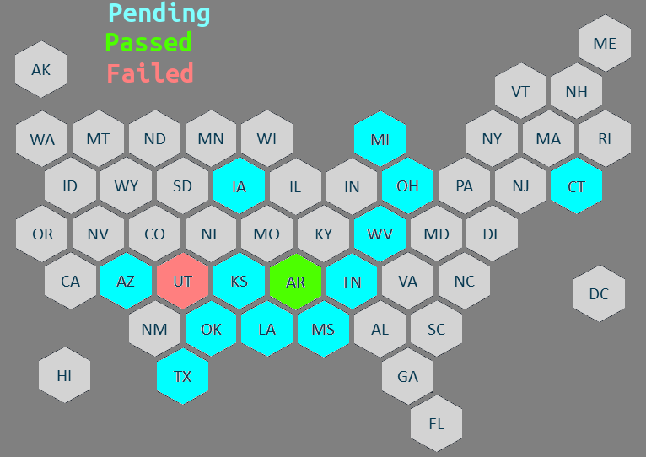
2025 Alt Currency Legislation
Notes:
March 27, 2025: Utah passes the first gold depository / digital currency bill, vetoed by Governor
April 17, 2025: Arkansas passes gold depository / digital currency bill

Slide 33
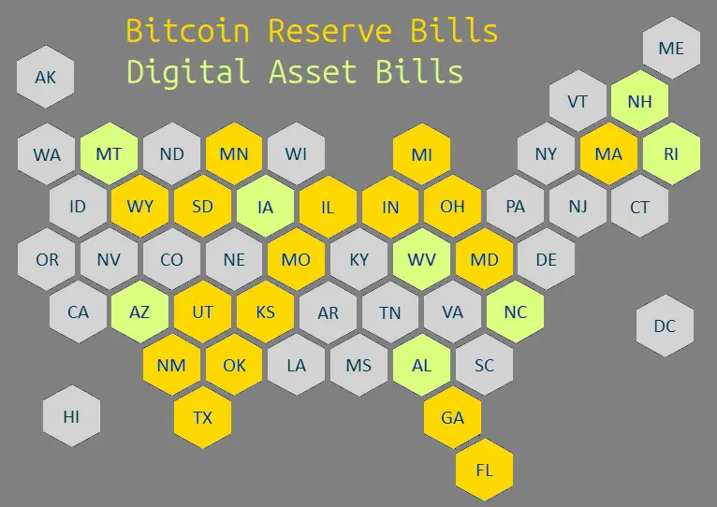
2025 Bitcoin Reserve Legislation
Notes:
Digital Asset Bills have a broader scope than Bitcoin Reserve bills, i.e. like XRP.

Slide 34
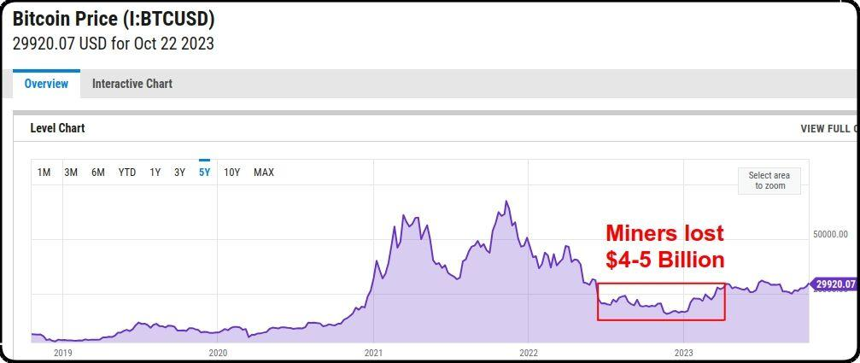
Bitcoin Miner Crash

Slide 35
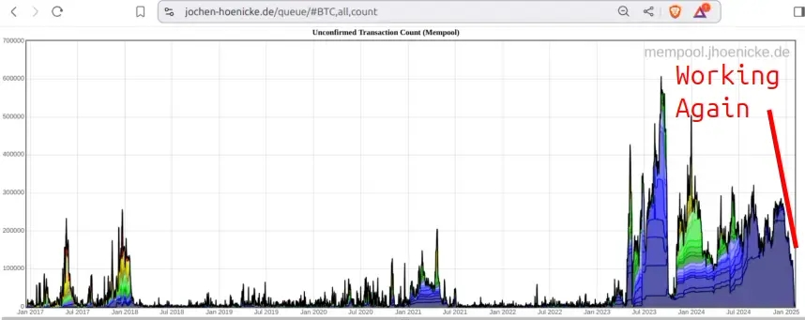
Impact On Bitcoin Mempool
Mempool was overflowed
1% to 5% of transactions expiring for 18 months

Slide 36
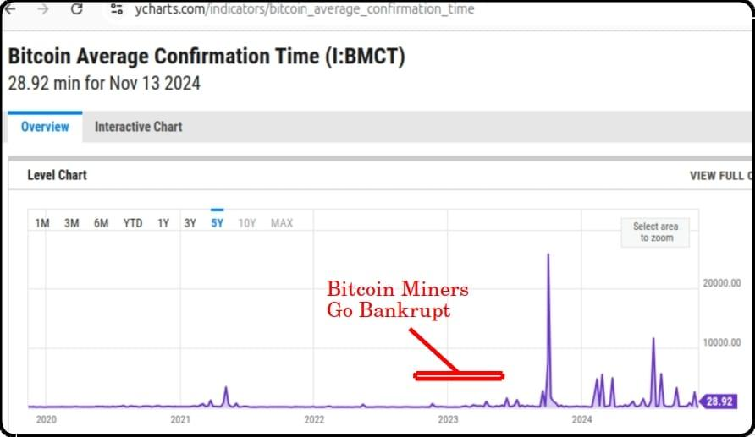
Impact On Bitcoin Confirmation Time

Slide 37
Certain Things Are Likely
Notes:
Dicey Predictions
Bitcoin resolves into either an A or S curve
AI enables cost-effective State crypto platforms

Slide 38
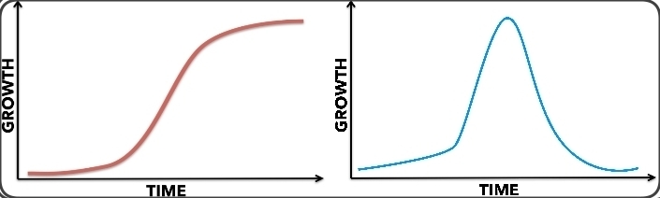
Bitcoin Scenarios: S-Curve Or A-Curve
Bitcoin uses 180 Terawatts annually, about $20 billion
Energy consumption is rising 25% per year
By the 2028 coin halving, energy cost will be close to $40 billion

Slide 39
State Token & Depositories
Many bills won’t pass in 2025 and will be resubmitted
I expect an increase in 2026 crypto legislation

Slide 40
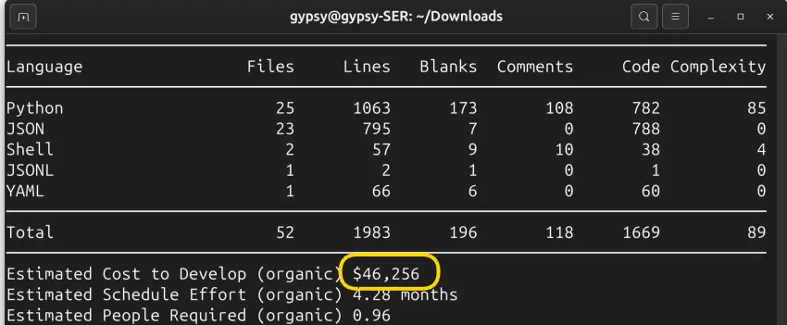
AI Augmentation
Code at Y Combinator's current startups are 95% written by AI.
“10 Engineers do the work of a team of 50”, says CEO Garry Tan.
My estimate is 2x to 3x increase.
I created this python code in a few days.

Slide 41
AI Augmentation
Marijuana businesses might support a State token system because it can function like cash. ChatGPT recommended these similar markets.
Adult Entertainment & Sex Work
Firearms & Ammunition Industry
Gambling & Online Betting
Psychedelic & Alternative Medicine Industry
Cryptocurrencies & Decentralized Finance (DeFi)
Unregulated Herbal & Supplement Markets

Slide 42
AI Considerations
non-deterministic nature impacts repeatable process
need a modified development methodology

Slide 43
Legislation Surprises in 2025
New York A 7807: Fiat-collateralized stablecoins as a form of bail
Texas SB 2922: Issuance and regulation of an oil-backed stablecoin
Wyoming Stable Token Commission
West Virginia HB 2463: make gold, silver, and crypto currency legal tender
West Virginia HB 2464: To create the State Bank of West Virginia
USDKG: USD-pegged, gold-backed stablecoin from Kyrgyzstan

Slide 44

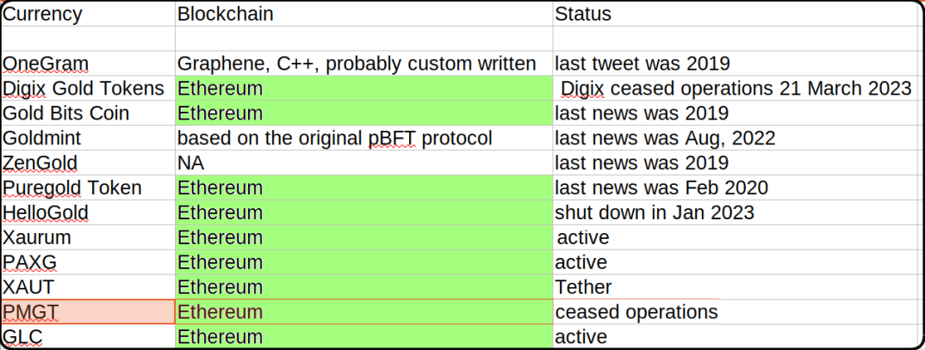
Private Gold-backed Cryptocurrencies (Me, 2023
They don’t age well

Slide 45
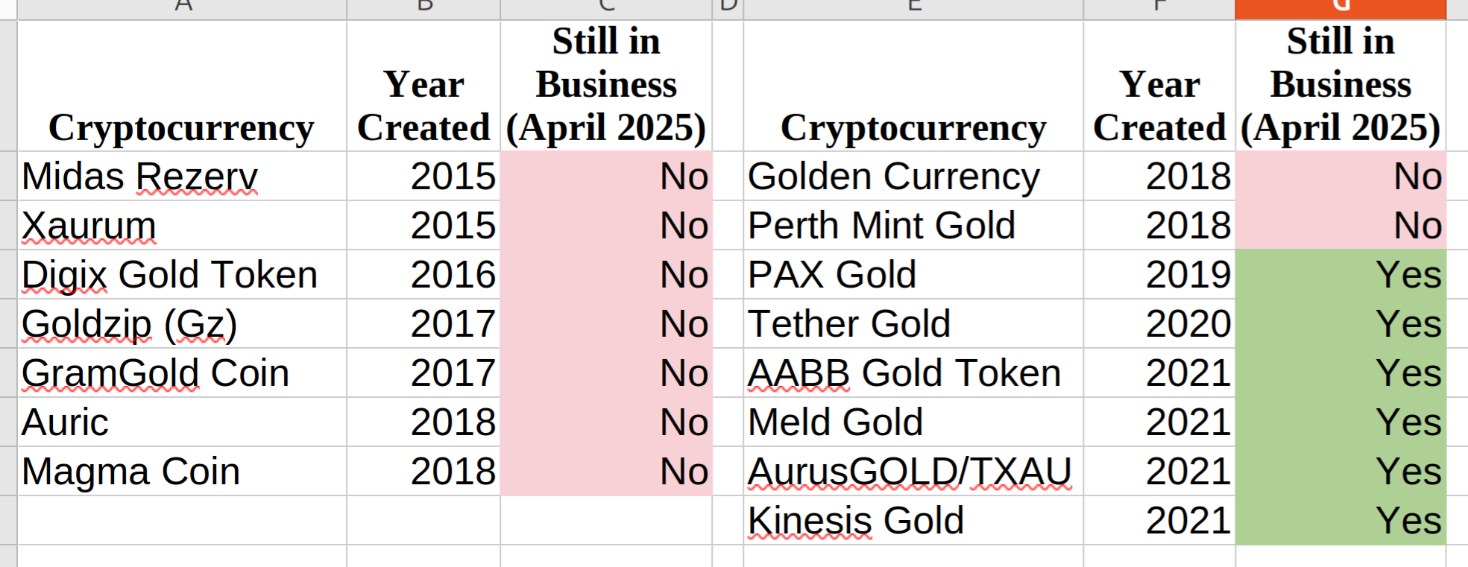
Private Gold-backed Cryptocurrencies (Grok, 2025)
Yup, They don’t age well

Slide 46
The End

Slide 47
Supplementary Slides For Questions / Comments
Private Crypto versus State Crypto
Annual income of largest Bitcoin miner, MARA: $650 million
Annual budget of State of Louisiana: $45 billion, almost 100X more.

Slide 48
Marijuana State Intersection
The intersection of marijuana-legal States and State depository candidates (blue names have bills for 2025)
Illinois
Massachusetts
Montana
Michigan
Arizona
New Jersey
New York
Rhode Island
Missouri
Ohio

Slide 49
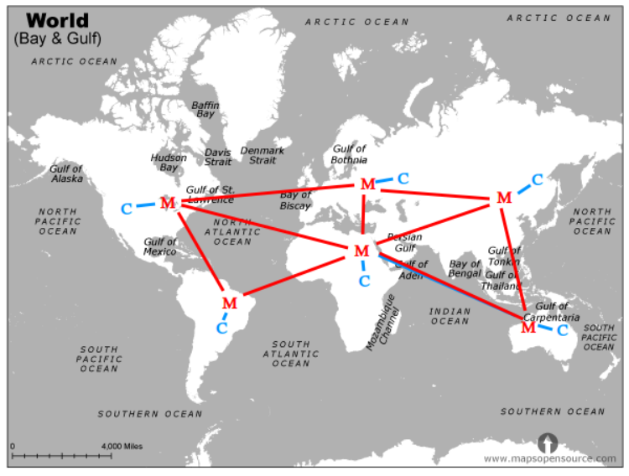
Bitcoin Miner Crash
Conceptual Diagram
Miner : Wallet ratio
1 million : 200 million
1 : 200
Notes:
Pre-crash abstract configuration

Slide 50
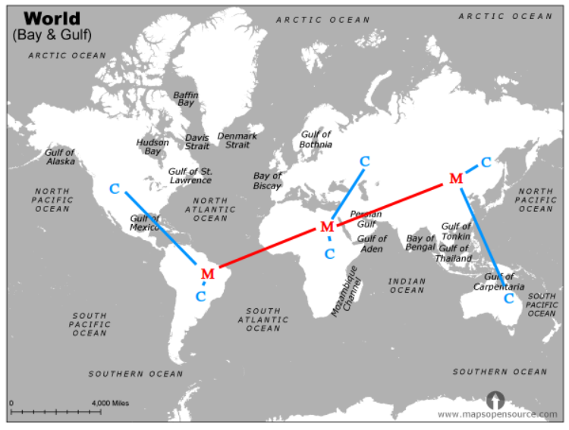
Bitcoin Miner Crash
Conceptual Diagram
Miner : Wallet ratio
500K : 200 million
1: 400
Each miner now serves twice as many wallets and over longer distances
Notes:
After Bitcoin miners lost $4 billion and half went bankrupt

Slide 51
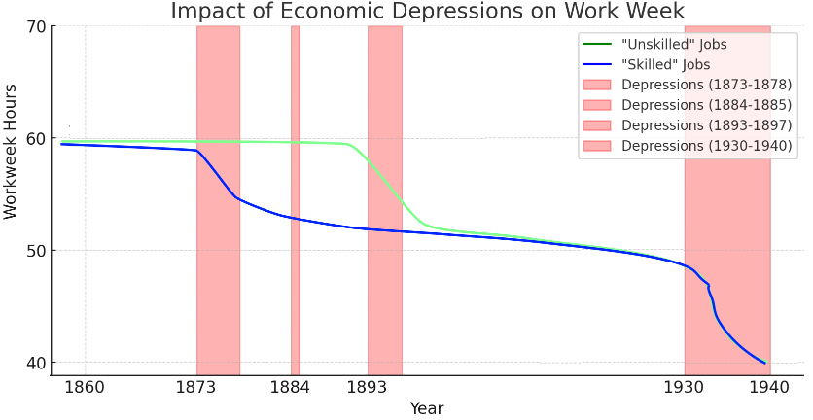
Likely Reduction In Workweek

Slide 52
A Bit Of NLP

Slide 53
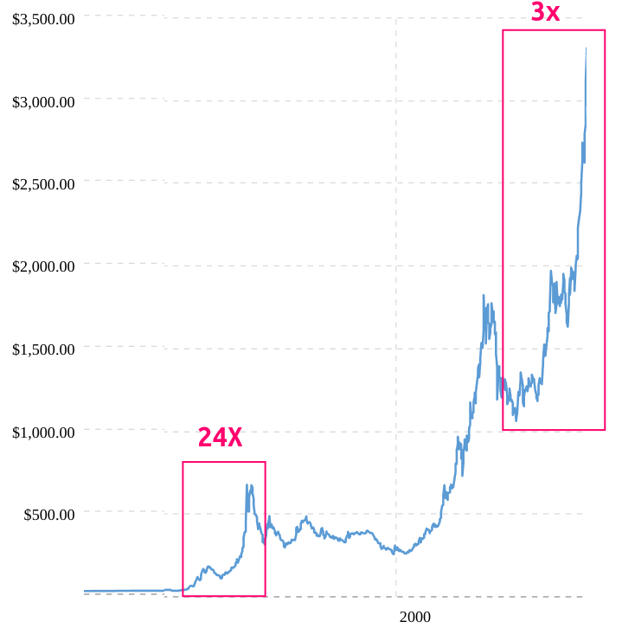
Gold
Notes:
1970s decade versus 2020s so far

